Slide 1

Hybrid of Regression Trees
& Linear Regression (HRT)

Slide 2

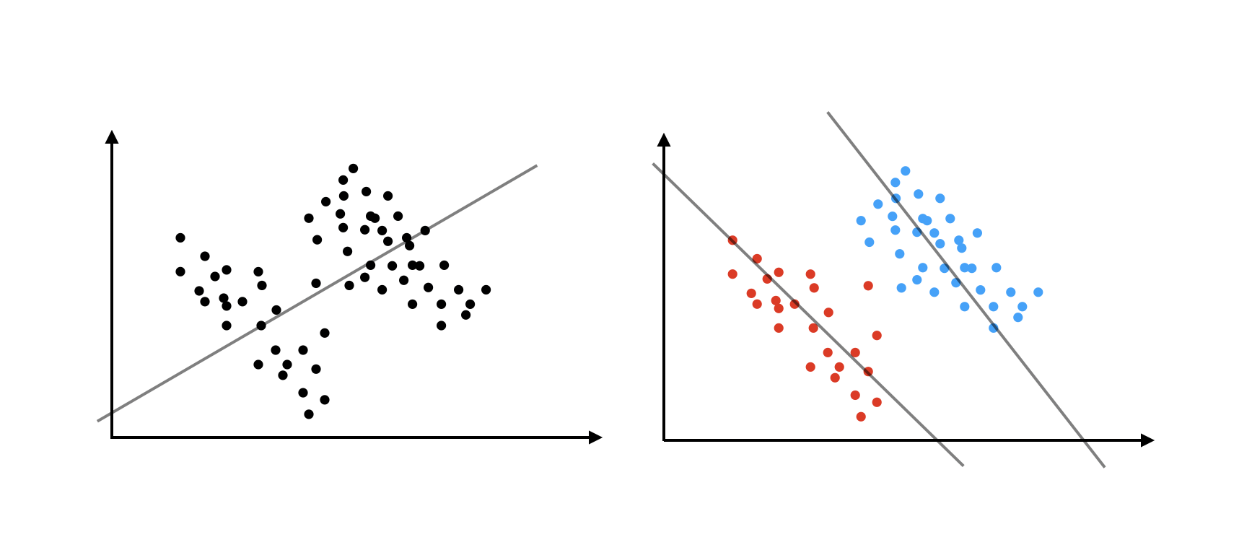
Problem Statement
Simpson’s paradox
A result that is present when data is put into groups that reverses or disappears when the data is combined

Slide 3
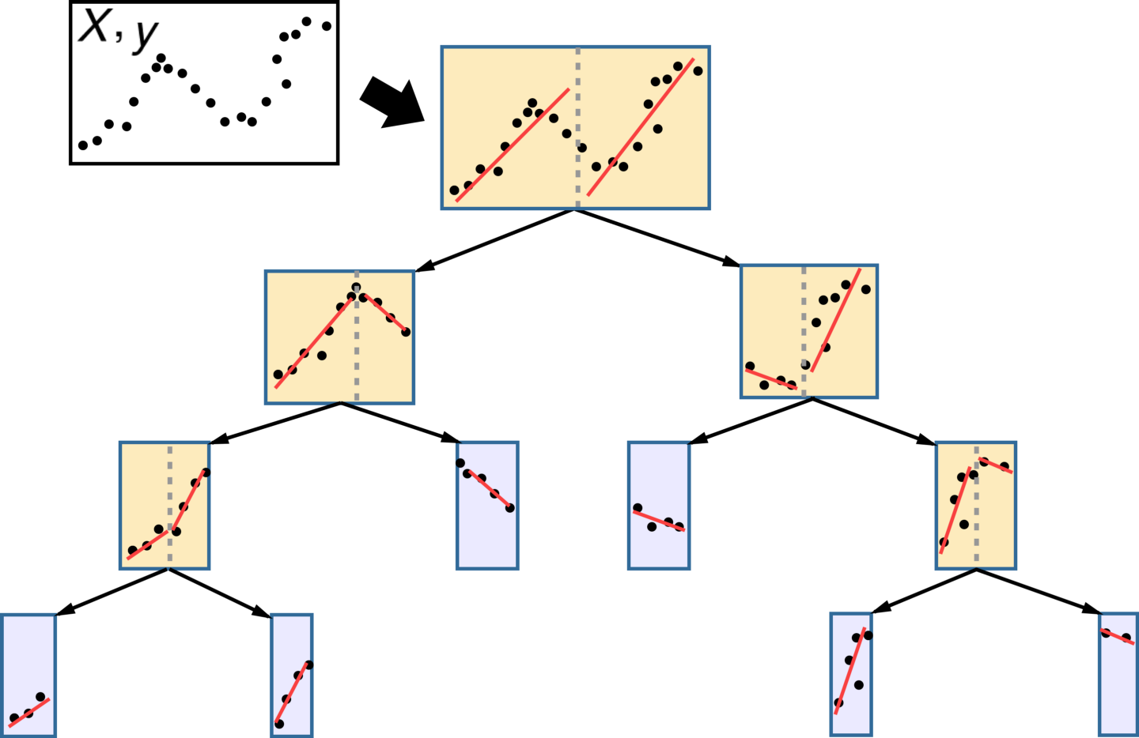
HRT - General Concepts
How does it work, advantages
Fits local linear regression in the leaves with alternative impurity measure*
+ Explainability
+ Non-linearity
+ Requires small tree depth
+ Can be run in parallel
Is trained longer than LR, GBT
Ensemble Hybrid is not explainable
Poorly covers feature interaction
*Linear Regression in Regression Tree Leaves. A.Karalik (1992)

Slide 4
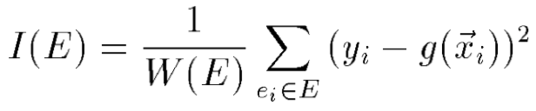
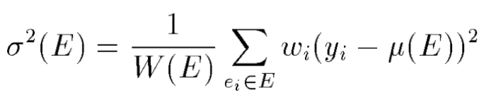






Deep Dive in Theory
Hybrid Regression Tree
Basic CART
Class value is estimated as linear function of attributes;
Impurity measure of an example set E:
Class value is estimated as constant value;
Impurity measure of an example set E - estimate of variance of the class values:
Function g represents the regression plane through the example set.
Here is the weight of example. ,
- sum of example weights,
- mean class value.
Expected utility of the split - defined in similar way as for CART.
Expected utility of the split:
Here - probabilities of transitions into left/right son of the node,
- corresponding impurities.

Slide 5


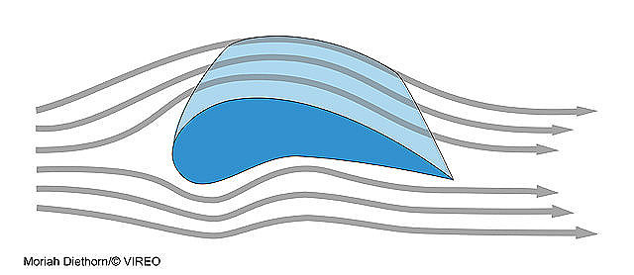
Datasets
PIK
StarSkill
Airfoil
Goal: Predict flats sales
Metric: RMSE
Shape: (8726, 47)
Data:
Flats characteristics
Macroeconomic data
Geo data
Goal: Predict unique units made per timestamp
Metric: RMSE
Shape: (3395, 20)
Data:
Game attributes
Players actions
Goal: Sound pressure level prediction
Metric: RMSE
Shape: (1503, 6)
Data:
NASA data, aerodynamics and acoustic tests of airfoil blade sections

Slide 6
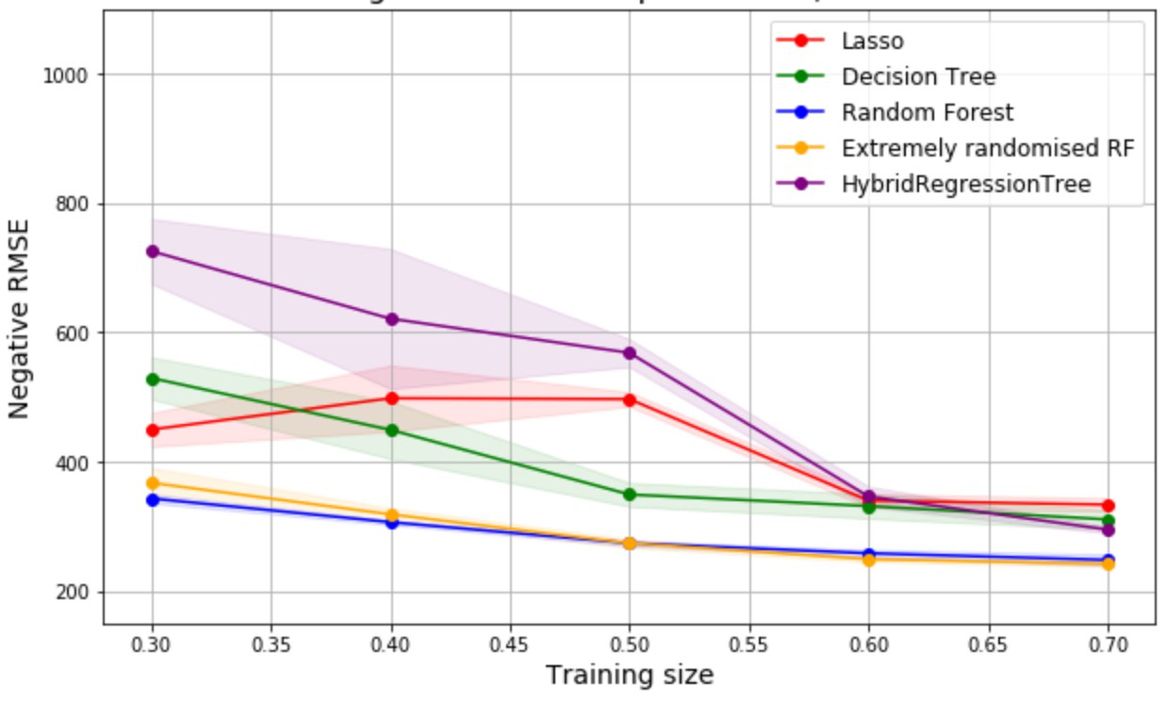
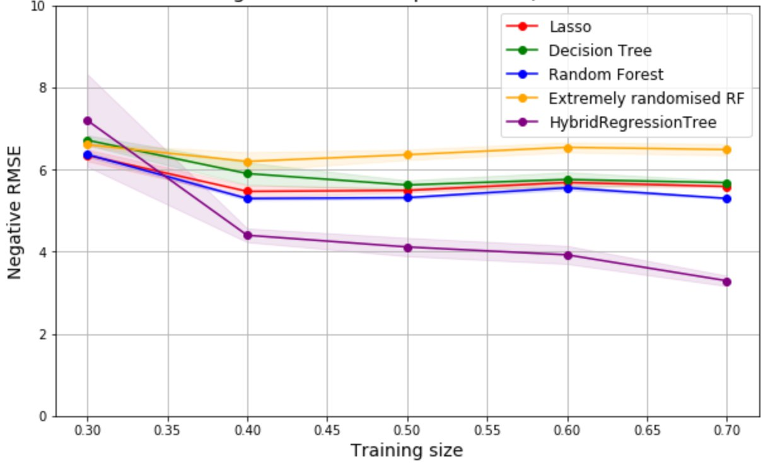
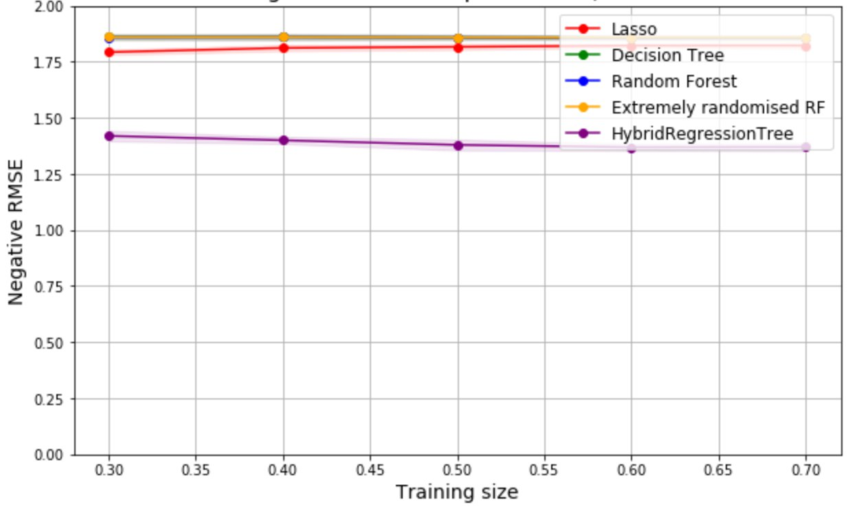
Comparison – Forecasting Quality
PIK
SkillCraft
Airfoil
HRT outperforms other methods for 2/3 datasets
The better Lasso is, the better HRT is
HRT is dependent on the number of data it is trained on

Slide 7
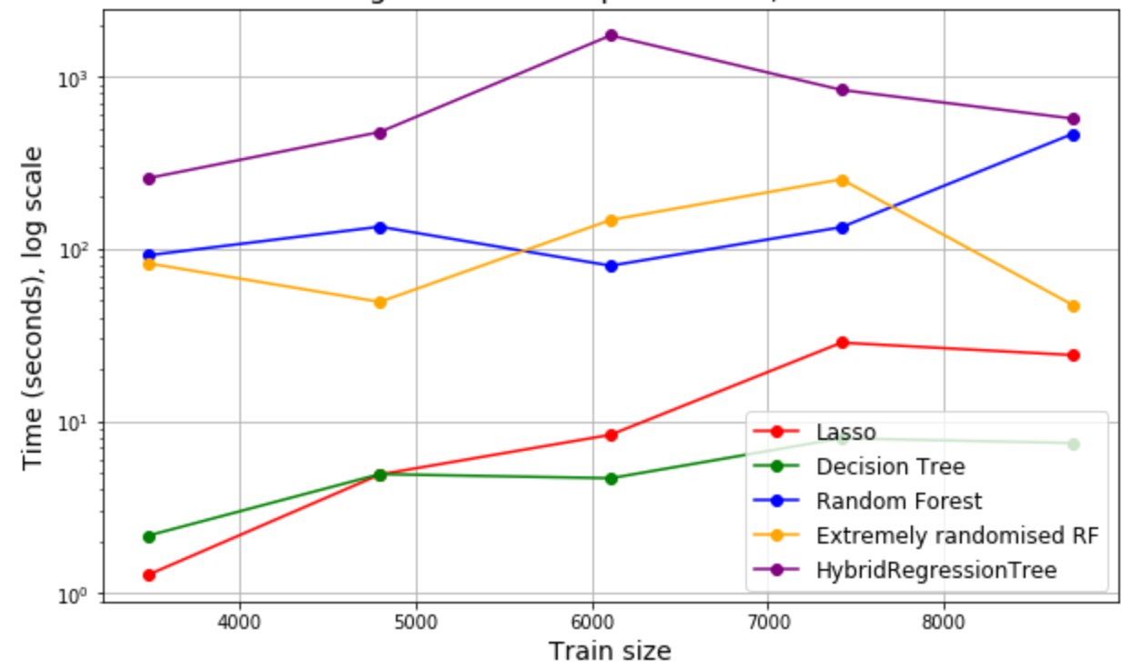
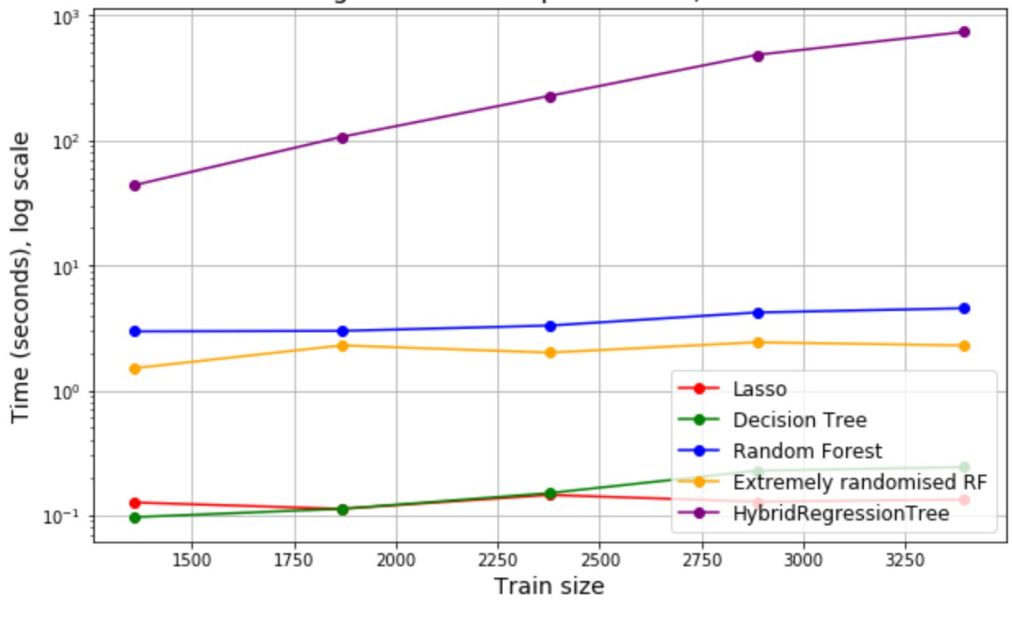
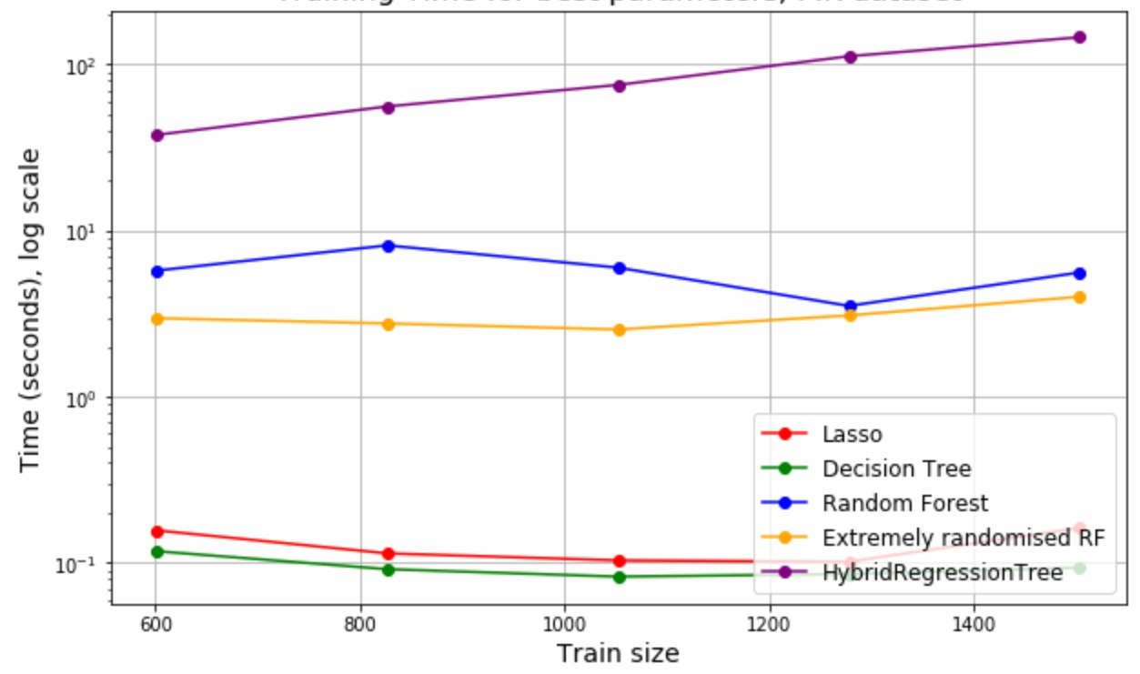
Comparison – Training Time
PIK
SkillCraft
Airfoil
HRT is trained longer than all other methods (as expected)
Its train time scale worse in train size than other methods
For larger datasets it could perform better than RF, ERRF

Slide 8
Conclusion & Further steps
Conclusion
Further steps
For some cases HRT outperforms RF, Extremely Randomized RF and Lasso
In general, HRT improves Lasso results
HRT captures non-linear data structure
HRT is sensitive to the number of data it is trained on
HRT is computationally expensive
HRT is suitable for middle size datasets
Compare HRT to GBT
Consider other algorithm in leafs except linear regression
Implement HRT with parallelization
Apply HRT to big data sets

Slide 9





Our Team
Input of each team member was focused on, but not restricted to:
Gazdieva Milena:
HRT theory
HRT code
Data cleansing
Maksimov Ivan:
HRT ensembles
Pipeline
Benchmarks
Belikova Kristina:
HRT code
Benchmarks
Results analysis
Nikita Alexeichyk:
HRT debugging
Pipeline
Visualization
Mikhail Kuzin:
HRT debugging
Feature engineering
Visualization

